Slide 1
Morphology
Digital Image Processing
Allann Jones

Slide 2
Boundary Extraction
Morphology

Slide 3
Boundary Extraction Definition
Boundary of a set A of foreground pixels:
β(A) = A – (A Ɵ B)
Where
A = Original image.
β(A) = A’s border.
Ɵ = Erosion operator.
B = Structuring element.

Slide 4
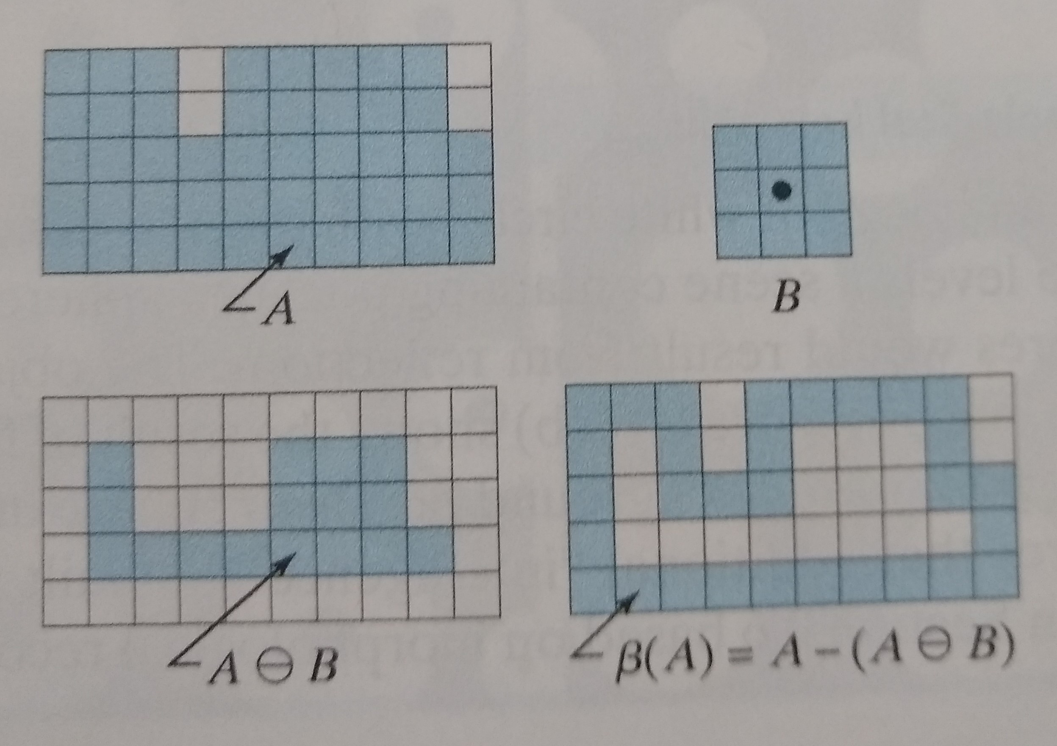

Boundary Extraction Implementation

Slide 5
Boundary Extraction Implementation
https://github.com/allanjos/image_processing/blob/master/master_degree/morphology/morphology_boundary_extraction.m

Slide 6
Hole Filling
Morphology

Slide 7
Holly Filling Definition
Each boundary enclosing a background region (i.e., a hole).
X_{k} = (X_{k-1} Ꚛ B) Ո I^{c} k = 1, 2, 3, ...
Until X_{k =} X_{k-1}
X₀ is the position of the boundary of the hole.
Ꚛ is the dillution operator.
B is a symmetric structuring element (SE).
Ո is the intersection operation
I^{c} is the complement of original image.

Slide 8
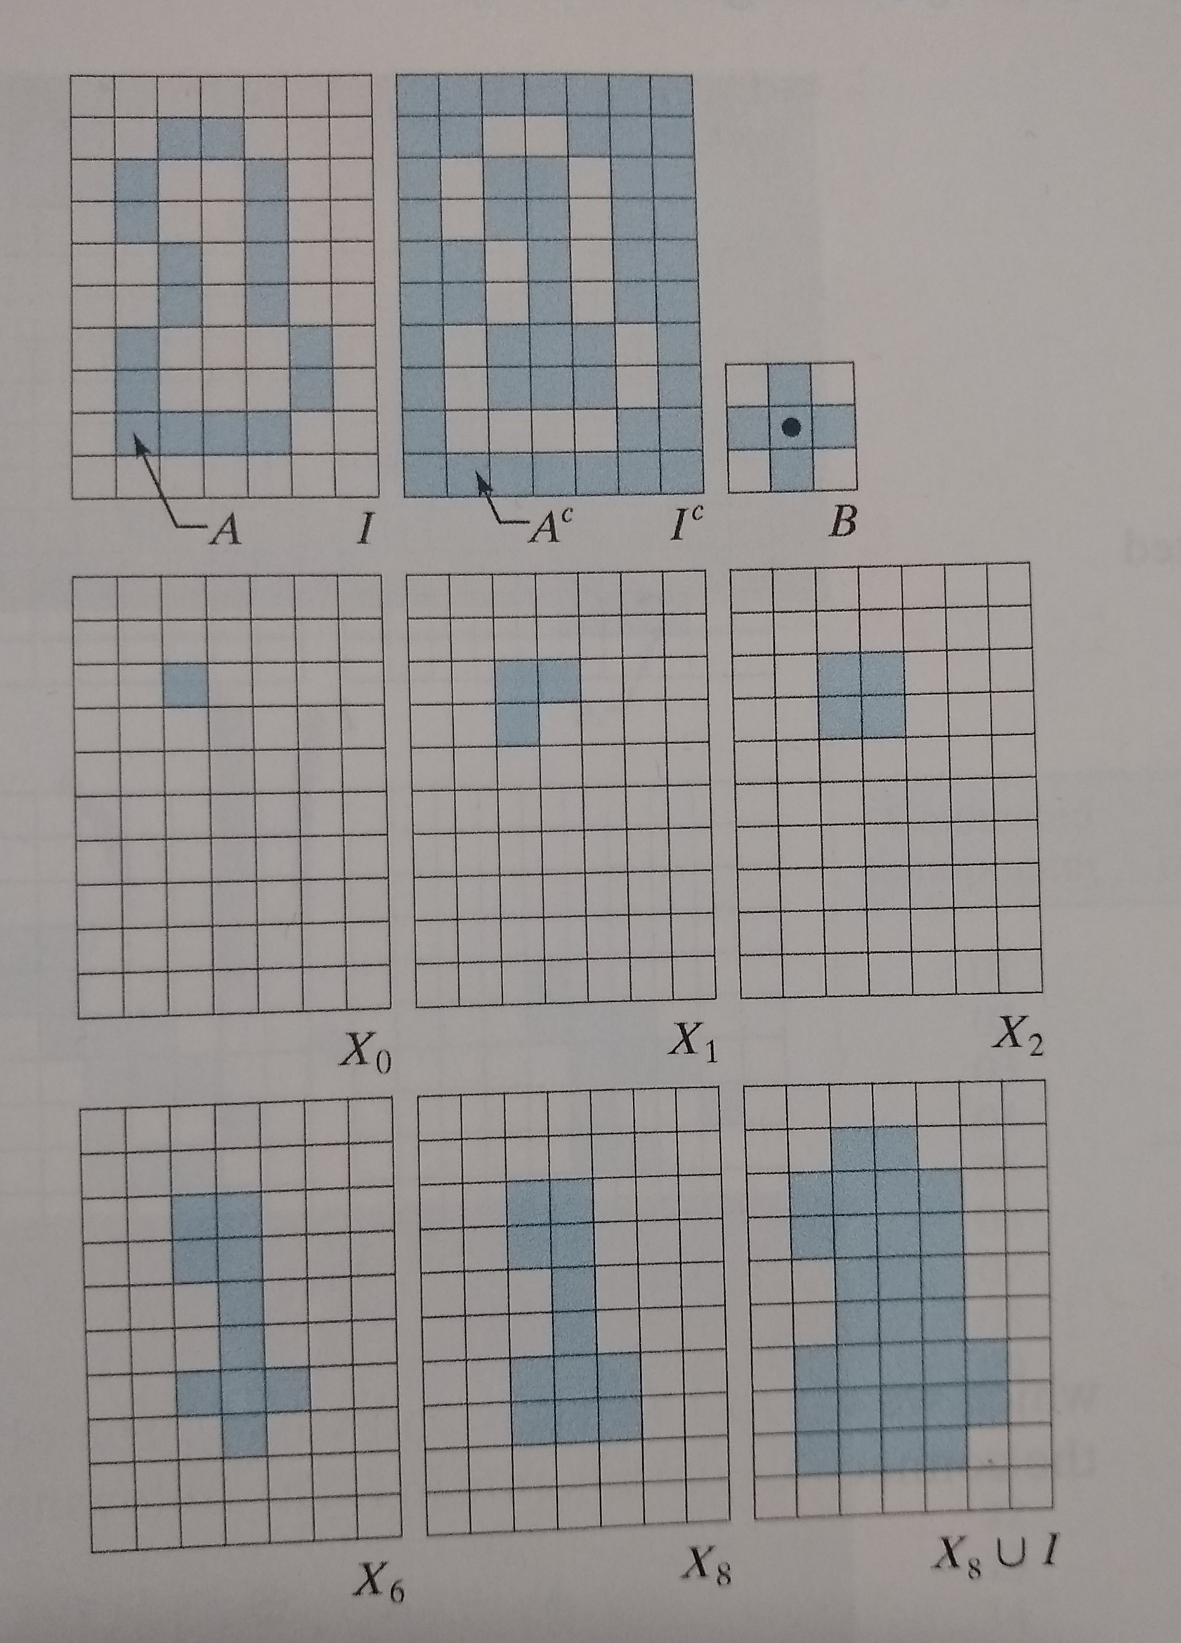
Holly Filling Implementation

Slide 9
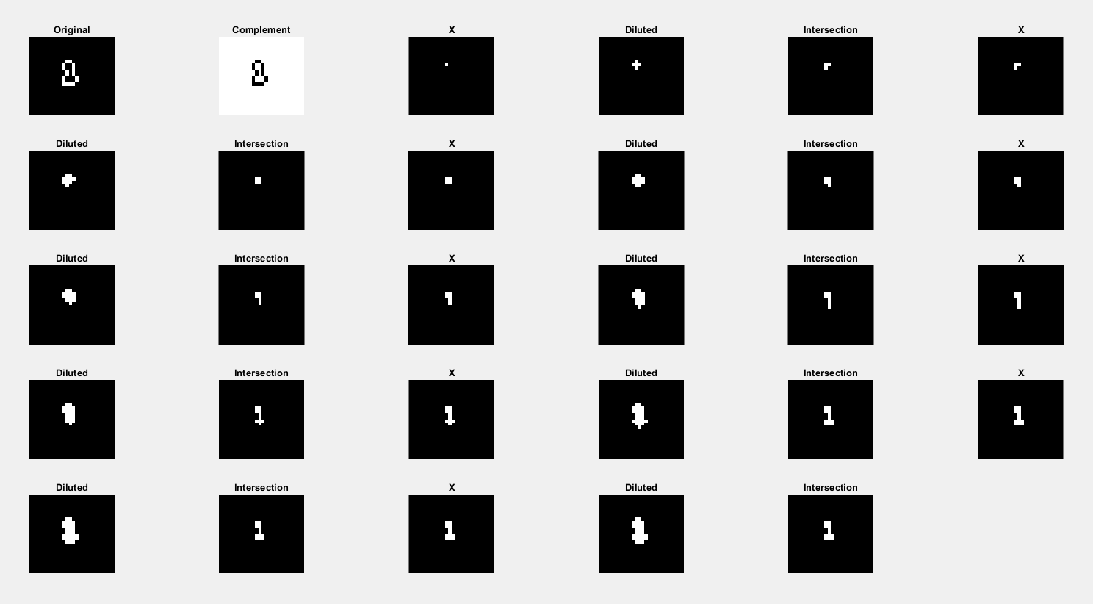
Holly Filling Implementation

Slide 10
Holly Filling Implementation
https://github.com/allanjos/image_processing/blob/master/master_degree/morphology/morphology_hole_filling.m

Slide 11
Extraction of Connected Components
Morphology

Slide 12
Extraction of Connected Components Definition
Extract connected components (foreground pixels) from a binary image.
Each boundary enclosing a background region (i.e., a hole).
X_{k} = (X_{k-1} Ꚛ B) Ո I k = 1, 2, 3, ...
Until X_{k =} X_{k-1}
X₀ is the position of the boundary of the hole.
Ꚛ is the dillution operator.
B is a symmetric structuring element (SE).
Ո is the intersection operation
I is the original image.

Slide 13
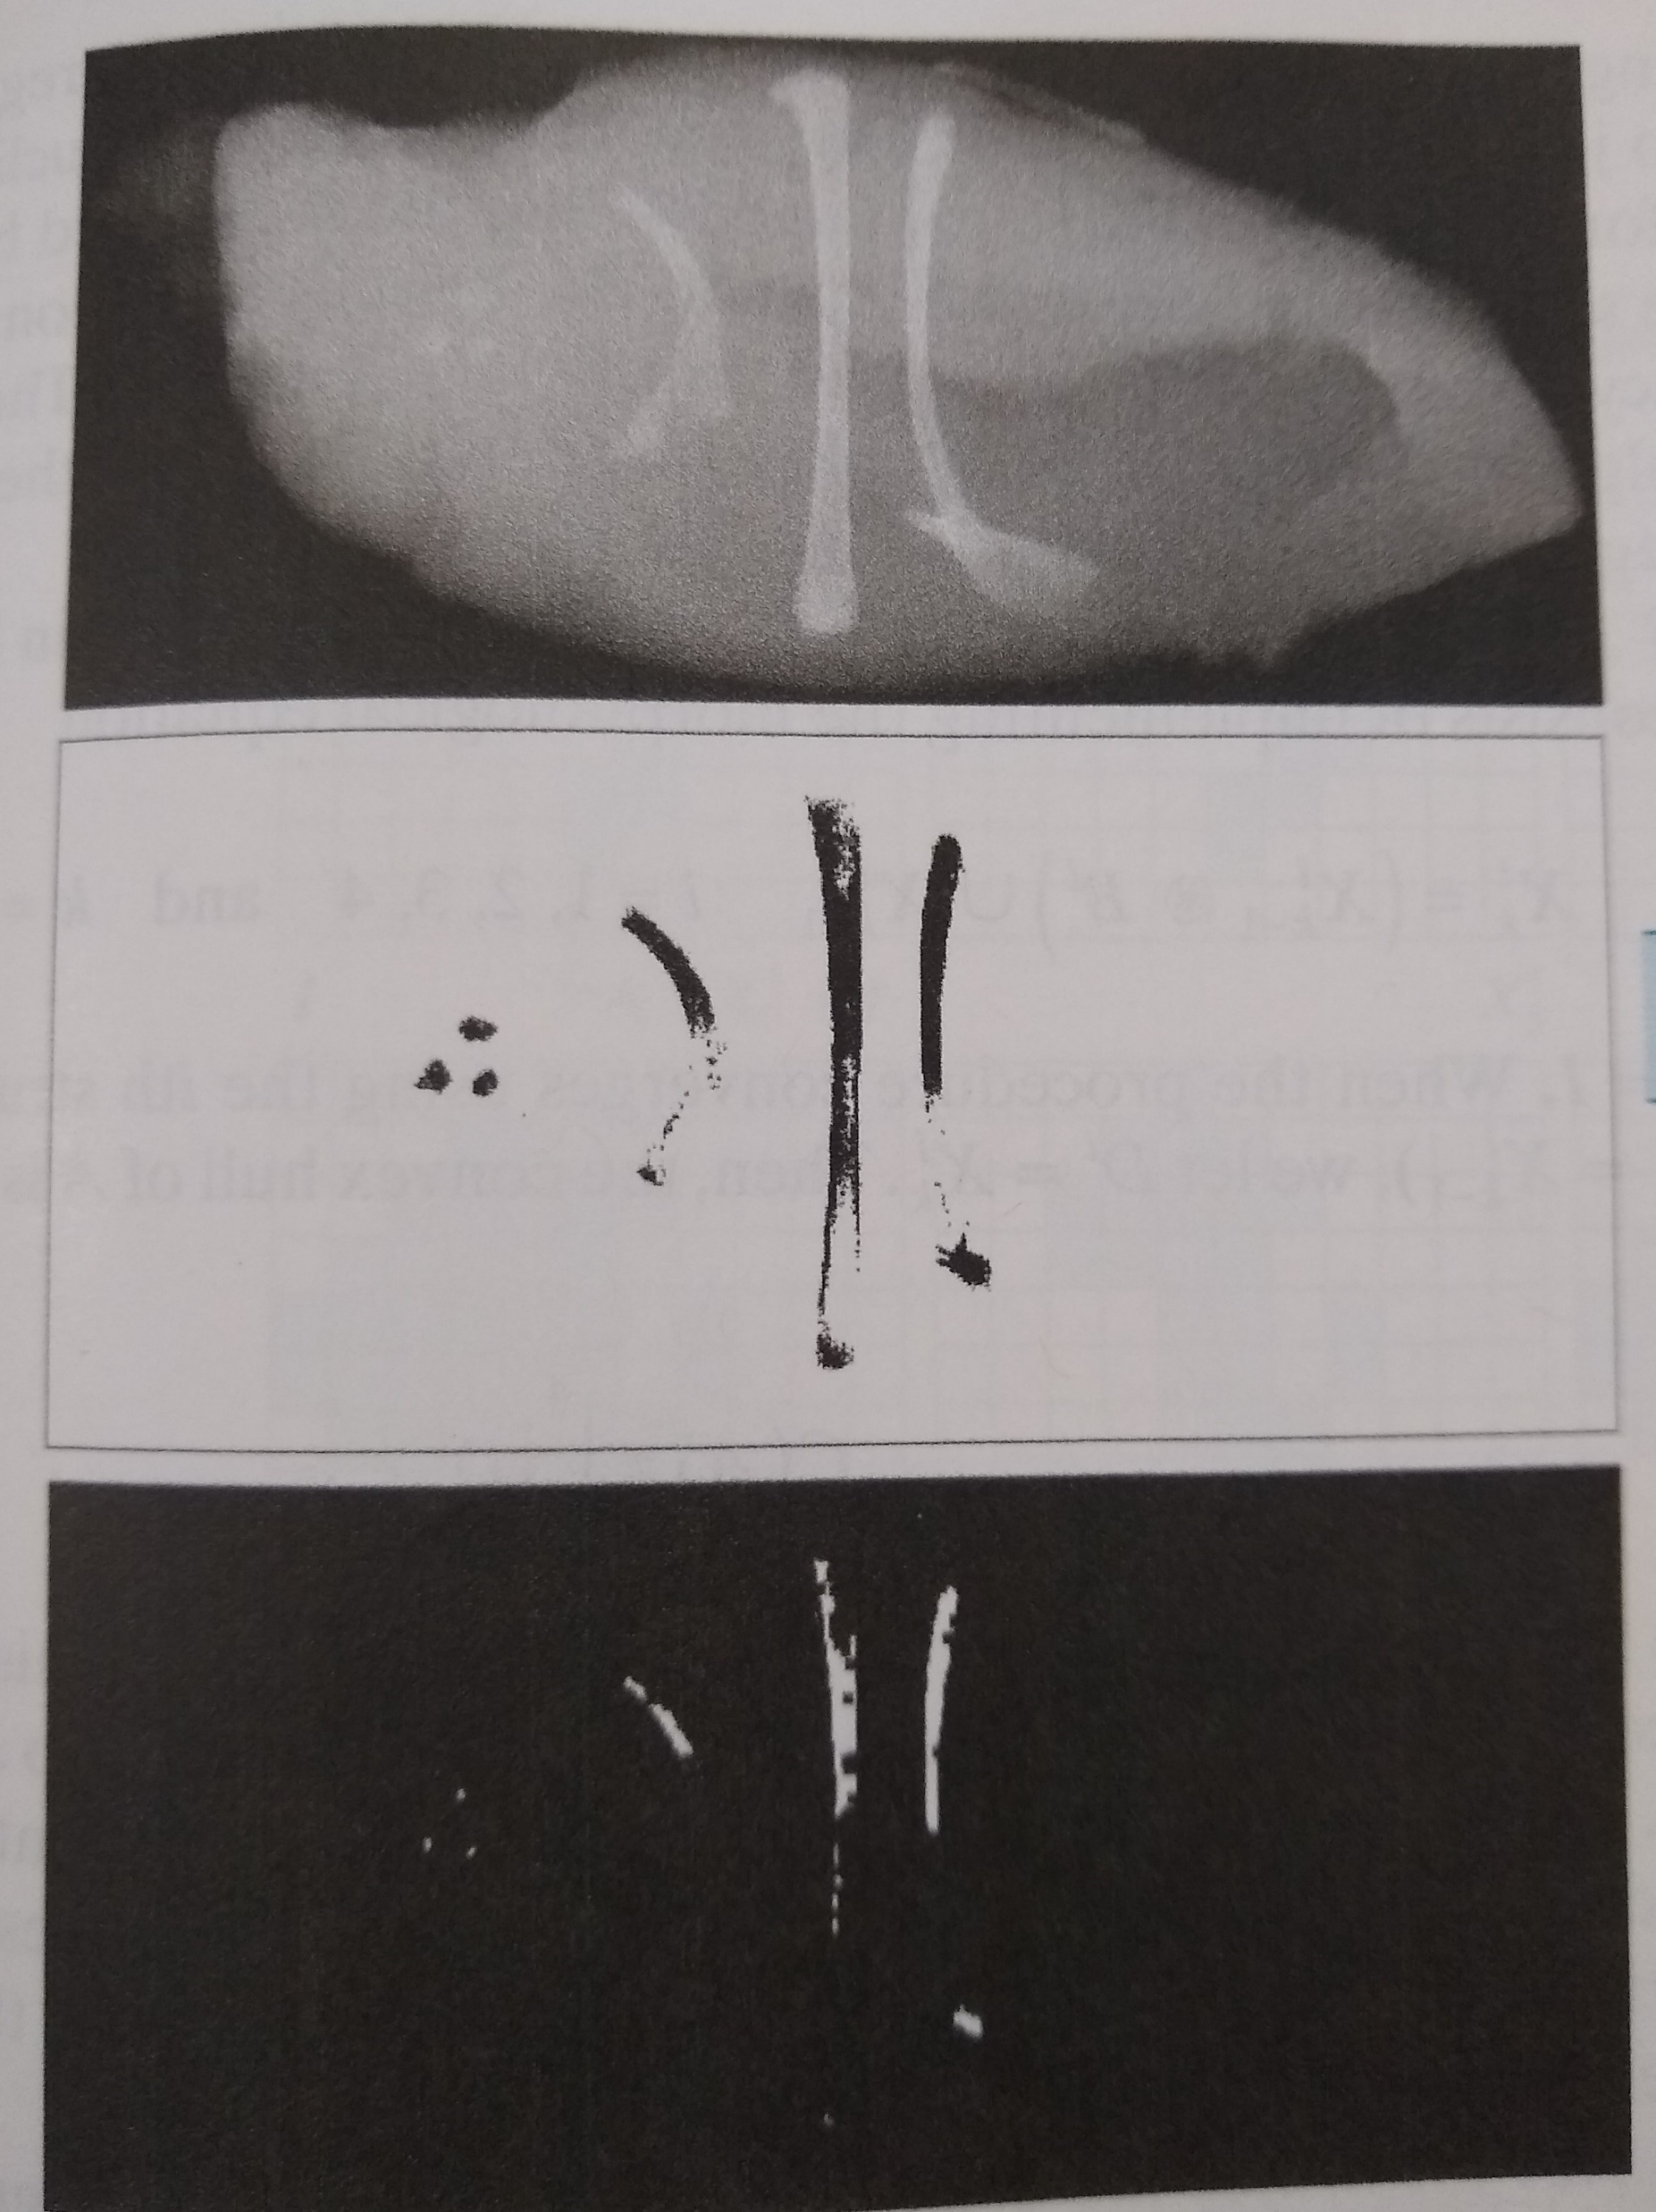
Extraction of Connected Components Application

Slide 14
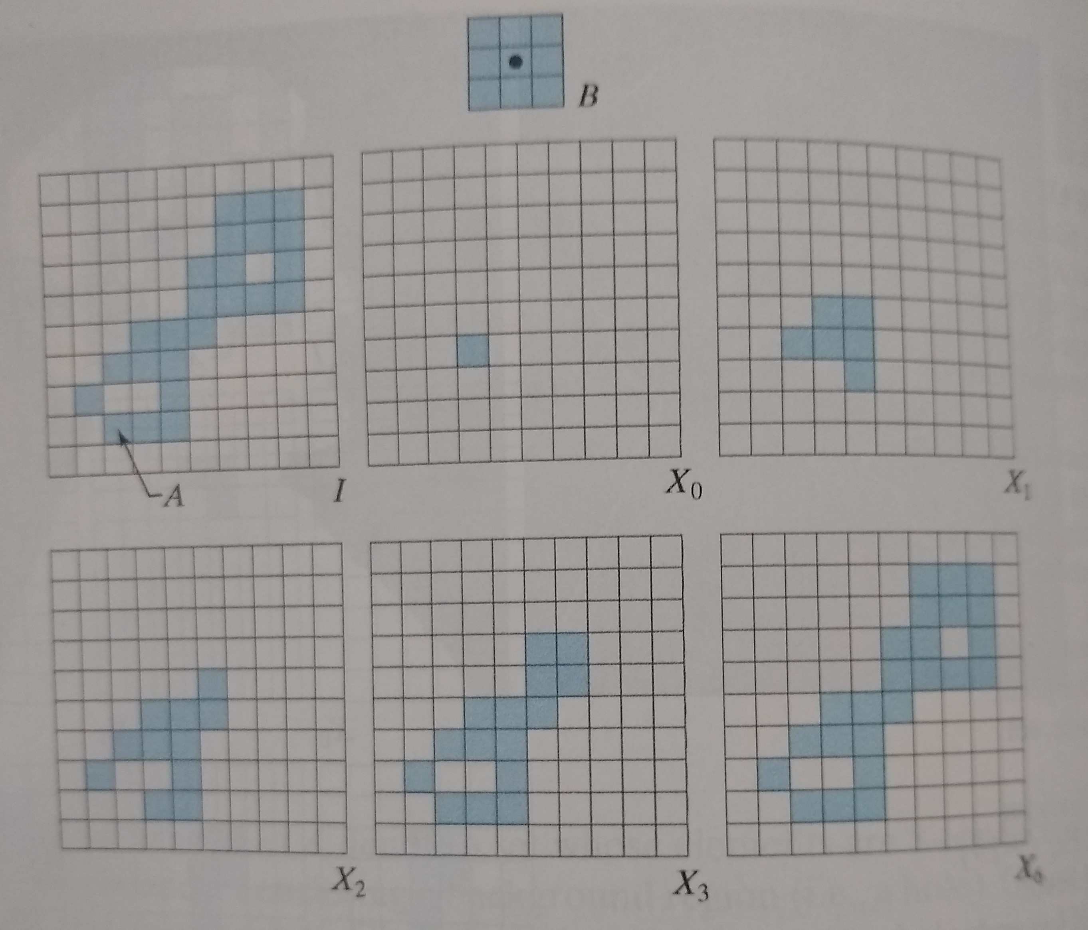
Extraction of Connected Components Implementation

Slide 15
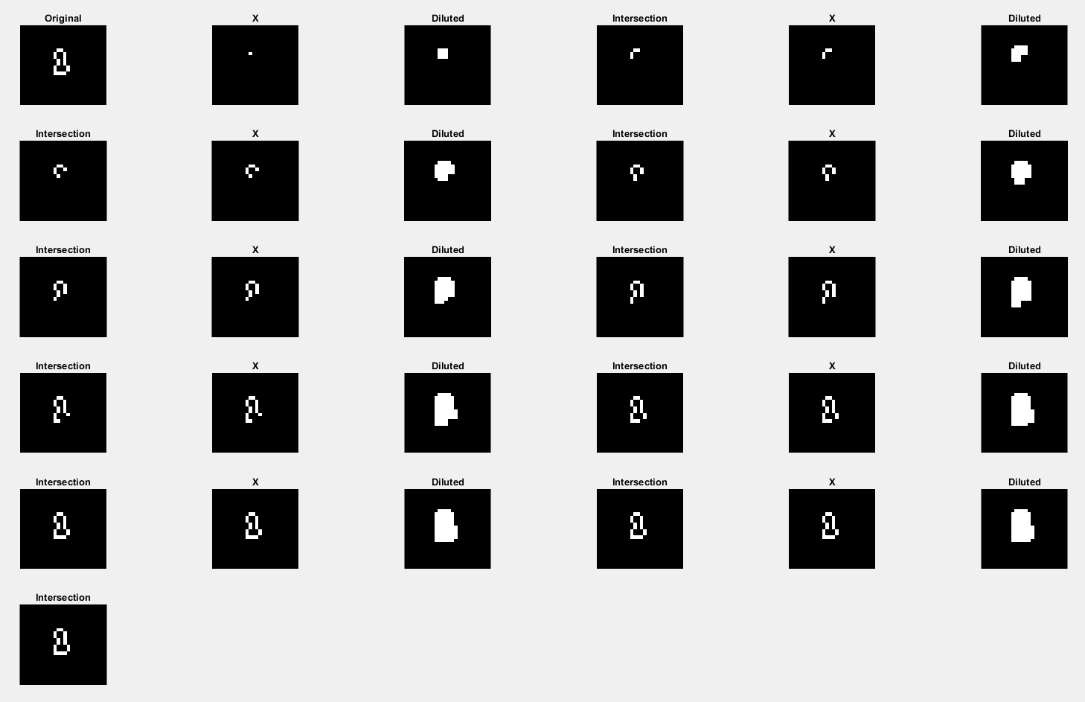

Slide 16
Extraction of Connected Components Implementation
https://github.com/allanjos/image_processing/blob/master/master_degree/morphology/morphology_extract_connected_components.m

Slide 17
Convex Hull
Morphology

Slide 18
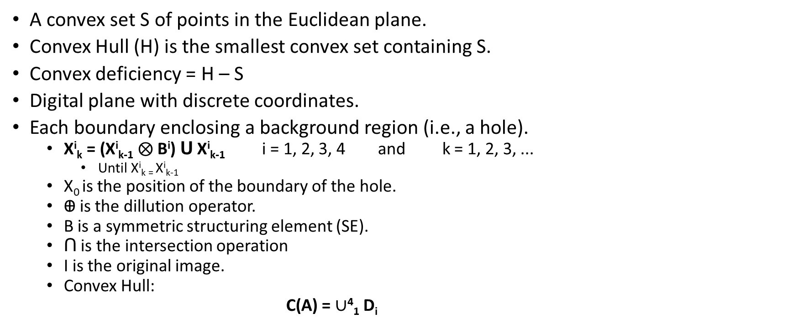
Convex Hull Definition
A convex set S of points in the Euclidean plane.
Convex Hull (H) is the smallest convex set containing S.
Convex deficiency = H – S
Digital plane with discrete coordinates.
Each boundary enclosing a background region (i.e., a hole).
X^{i}_{k} = (X^{i}_{k-1} $⨂$ B^{i}) Ս X^{i}_{k-1} i = 1, 2, 3, 4 and k = 1, 2, 3, ...
Until X^{i}_{k =} X^{i}_{k-1}
X₀ is the position of the boundary of the hole.
Ꚛ is the dillution operator.
B is a symmetric structuring element (SE).
Ո is the intersection operation
I is the original image.
Convex Hull:
C(A) = $∪$⁴₁ D_{i}

Slide 19
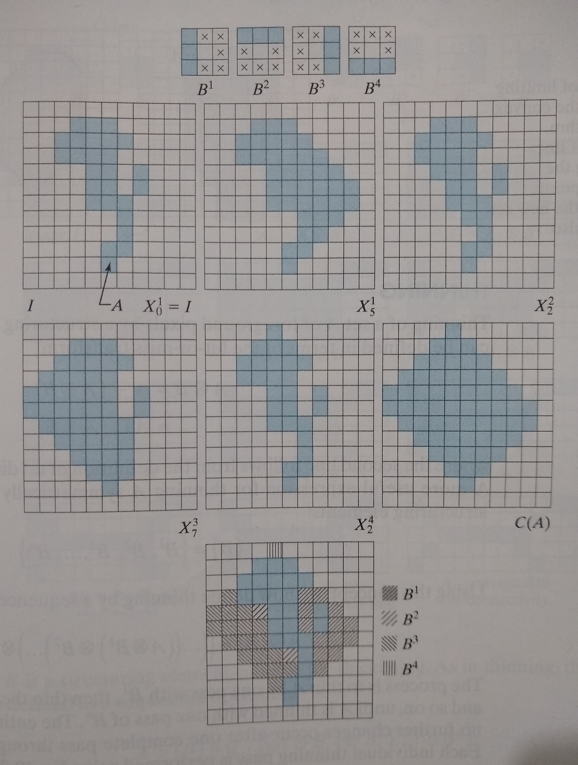
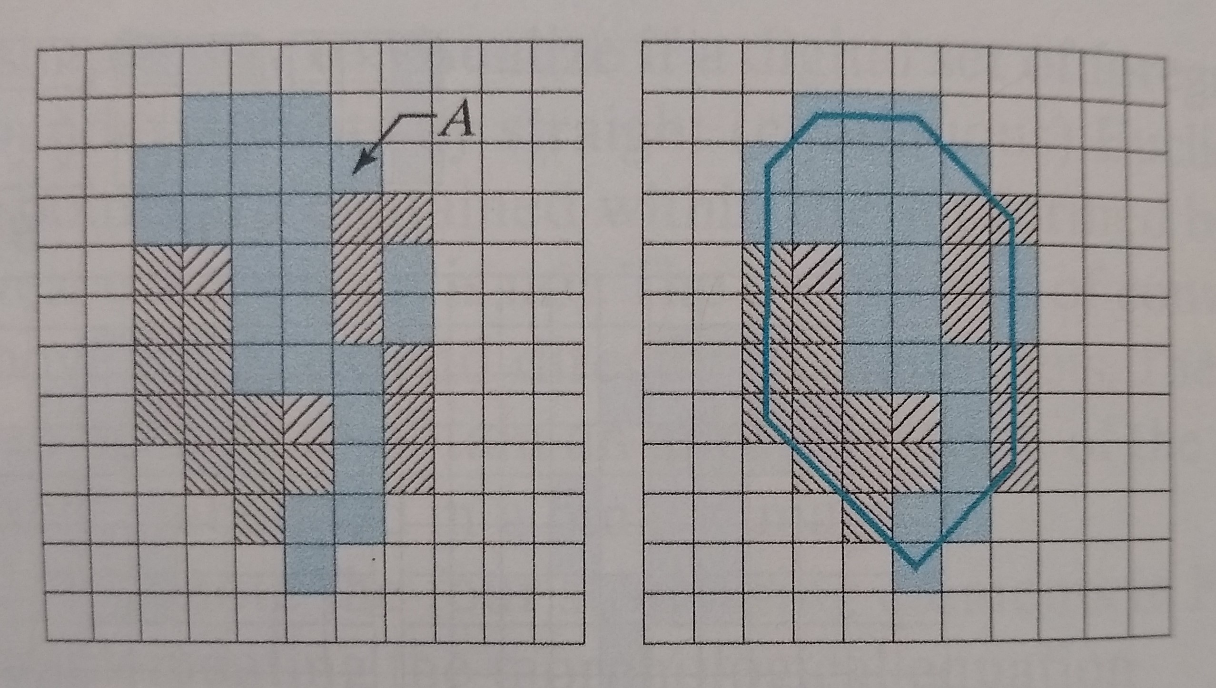
Convex Hull Implementation

Slide 20
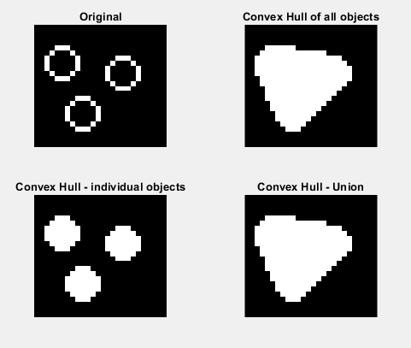
Convex Hull Implementation

Slide 21
Convex Hull Implementation
% Original image (Binary) subplot(2, 2, 1); imgOriginal = imread('convex_hull_bw.tif'); imshow(imgOriginal); title('Original'); % Convex Hull of all objects in the image subplot(2, 2, 2); convexHull = bwconvhull(imgOriginal); imshow(convexHull); title('Convex Hull of all objects'); | % Convex Hull individual foreground objects subplot(2, 2, 3); convexHullObjects = bwconvhull(imgOriginal, 'objects'); imshow(convexHullObjects); title('Convex Hull - individual objects’); % Convex Hull – union of all objects subplot(2, 2, 4); convexHullObjects = bwconvhull(imgOriginal, 'union'); imshow(convexHullObjects); title('Convex Hull - Union');

Slide 22
Bibliography
[1] CETELI / Digital Image Processing courseware: Marly Guimarães.
[2] Digital Image Processing (4th Edition): Rafael C. Gonzalez, Richard E. Woods.
[3] Matlab documentation.

